Slide 1

Lab 10
FIT5202 Big Data Processing
Data Streaming using Apache Kafka and Spark

Slide 2
Student Evaluation of Teaching and Units (SETU)
Please consider taking 5 minutes to complete the SETU

Slide 3
Lab 09 Agenda
•
Lab 08 Review
•
Spark Streaming Basics
•
Implicit vs Explicit Data
•
Lab Task : Click Stream Analysis and
•
Matrix Factorization
Visualization
•
Collaborative Filtering with ALS
•
Streaming using Apache Kafka
Work on Assignment
•
Kafka Producer
•
Kafka Consumer
•
Visualizing in real-time
•
Use case : Clickstream visualization

Slide 4

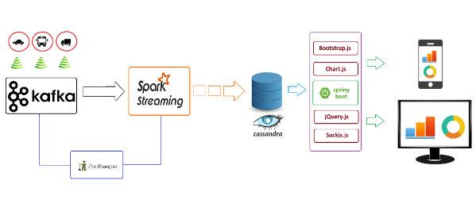
Kafka Use Case (Traffic Data Monitoring)
https://www.infoq.com/articles/traffic-data-monitoring-iot-kafka-and-spark-streaming/

Slide 5
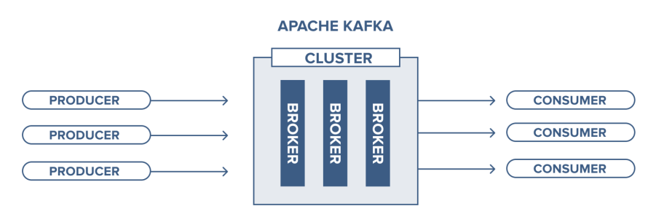
What is Apache Kafka?
•
Publish-subscribe messaging system
•
Enables distributed applications
•
Brokers utilize Apache ZooKeeper for management
and coordination of the cluster
•
Each broker instance is capable of handling read
and write quantities reaching to the hundreds of
thousands each second (and terabytes of
messages) without any impact on performance.
https://www.cloudkarafka.com/blog/2016-11-30-part1-kafka-for-beginners-what-is-apache-kafka.html
https://www.instaclustr.com/apache-kafka-architecture/

Slide 6









Environment
Docker Container
Docker Container
Jupyter Notebook Server
Web Browser
Docker Container
Bind Mount
Local Folder(Jupyter, data files)
Operating System(Windows/Linux/MacOS)
“ZooKeeper is a centralised service for maintaining configuration information, naming, providing distributed synchronisation, and providing group services.”
Step 1: docker run -d --network fit5202 --name zookeeper -p 2181:2181 monashfit/fit5202-zookeeper
Step 2:
docker run -d --network fit5202 --name kafka -e KAFKA_ZOOKEEPER_CONNECT=zookeeper:2181 -e KAFKA_ADVERTISED_HOST_NAME=kafka -p 9092:9092 monashfit/fit5202-kafka
All timezones in three containers are UTC. It can be configured with TZ environment variable(e.g. -e TZ=Australia/Melbourne).

Slide 7
Kafka Implementation Scenarios for Lab
Visualize in Real-time
Aggregation +
Visualization
Multiple graphs,
Producer
Session9-Topic
annotating interesting
points
Rolling Mean +
Visualization
Real-time visualization
Producer (Multiple
Session9-Topic1
Multiple aggregations
Producers)
Multiple graphs

Slide 8
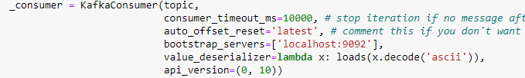
Kafka Producer and Consumer Properties
▪
KafkaProducer
▪
KafkaConsumer
•
Bootstrap_servers
•
Consumer_timeout_ms
•
Value_serializer
•
Auto_offset_reset
•
Api_version
•
Bootstrap_servers
•
Value_deserializer
•
Api_version
https://kafka-python.readthedocs.io/en/master/apidoc/KafkaConsumer.html

Slide 9

Lab Task for Kafka
Clickstream.csv
Real time visualization
Producer
clickstream
Kafka Consumer
Total clicks/ Total
impressions

